Slide 1

P.E.-III Digital Image Processing
Walchand college of Engineering,sangli
ISE- 2 Part 2: Mini Project
Presented By -
Sourabh Kanwade -2016BTECS00053
Yogesh Kumare -2017BTECS00109
Saikiran Naramwar-2016BTECS00079
Guided By Mr.Kiran P. Kamble

Slide 2
Problem Statement
Capture sample image contain object such as, coin or pills. Measure exact size of objects present in image.

Slide 3
Measuring the size of objects in an image with OpenCV
Measuring the size of objects in an image is similar to computing the distance from our camera to an object — in both cases, we need to define a ratio that measures the number of pixels per a given metric.

Slide 4
The “pixels per metric” ratio
pixels_per_metric = object_width / know_width
In order to determine the size of an object in an image, we first need to perform a “calibration” (not to be confused with intrinsic/extrinsic calibration) using a reference object. Our reference object should have two important properties:
Property #1: We should know the dimensions of this object (in terms of width or height) in a measurable unit (such as millimeters, inches, etc.).
Property #2: We should be able to easily find this reference object in an image, either based on the placement of the object (such as the reference object always being placed in the top-left corner of an image) or via appearances (like being a distinctive color or shape, unique and different from all other objects in the image). In either case, our reference should should be uniquely identifiable in some manner.

Slide 5
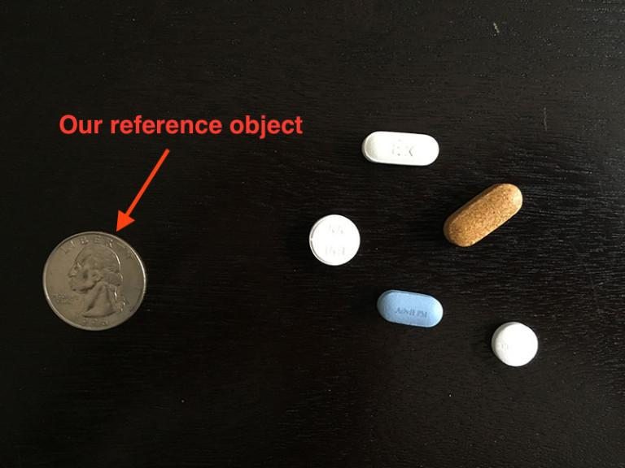
Example

Slide 6
In this example, we’ll be using the United States quarter as our reference object and throughout all examples, ensure it is always the left-most object in our image
A US quarter has a known_width of 0.955 inches. Now, suppose that our object_width (measured in pixels) is computed be 150 pixels wide (based on its associated bounding box).
The pixels_per_metric is therefore:
pixels_per_metric = 150px / 0.955in = 157px
Thus implying there are approximately 157 pixels per every 0.955 inches in our image. Using this ratio, we can compute the size of objects in an image.

Slide 7
Thank You !

